Slide 1

University of Toronto Data Visualization Boot Camp – Project Football
Mauricio Avila, Gurpreet Chug,
Jeremy Mallory, Doran Rainford
Gavin Toole, Anthony Verma

Slide 2






Question of Interest and Motivation
Do fans affect a teams winning percentage?
What statistic best predicts team success?
Which league is them most competitive?
The 6 major European Leagues were analyzed:
EPL – English Premier League
Serie A – Italian League
La Liga – Spanish League
Bundesliga -- German League
La Ligue – France League
UEFA Champions League

Slide 3

Class Polls

Slide 4
Analysis Process
Data was retrieved from: https://fbref.com/en
5 seasons of data were retrieved, cleaned and analyzed for each league and then combined to 2 DataFrames: Team Summary and Match Summary
Some cleaning difficulties included
Splitting of the score as the (5-3) the dash wasn’t a true dash. We had to split the cell to identify the character.
EPL_all_seasons_matches_df[['Home Score','Away Score']] = EPL_all_seasons_matches_df['Score'].str.split('–', expand=True)
Splitting the wages was also an issue as there were 3 values (Euro, Pounds Sterling, and Dollars)
EPL_2018_sum_complete_df[['pounds', 'dollars']] = EPL_2018_sum_complete_df['Annual Wages'].str.split('$', expand=True)
EPL_2018_sum_complete_df[['Annual Wages ($)', 'discard']] = EPL_2018_sum_complete_df['dollars'].str.split(')', expand=True)

Slide 5
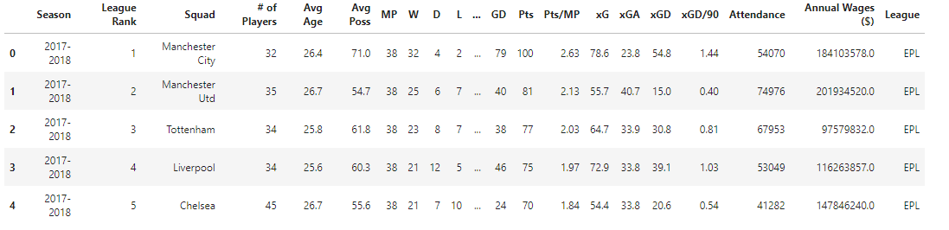
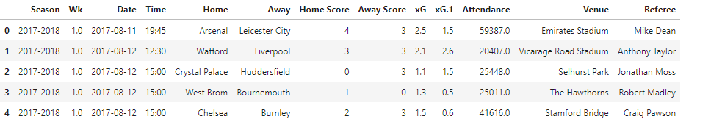
Analysis Process
2 Columns were added to both tables, Season and League to be used when combined for analysis
Team Summary 5 Seasons
Match Summary 5 Seasons
Notes:
Our outputs were saved as csv files to be combined during our analysis

Slide 6
Analysis Process
12 csv files were combined into 2 final DataFrames representing Team Summary for all leagues and 5 seasons and Match Summary for all leagues and 5 seasons
DataFrames were analyzed for null rows and consistence.

Slide 7
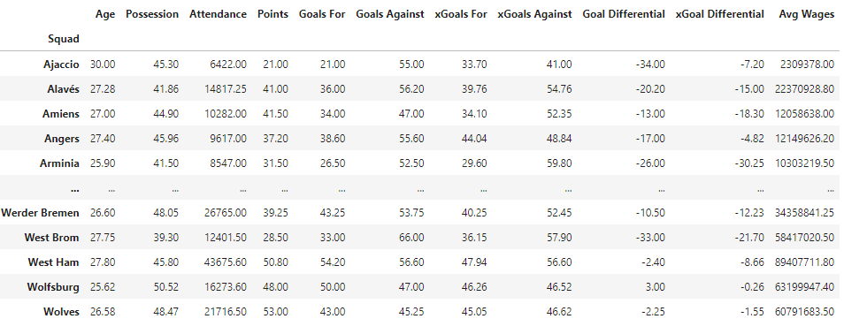
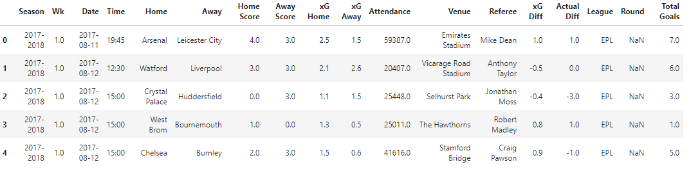
Analysis Process
Teams Summary DataFrame:
Matches Summary DataFrame:

Slide 8
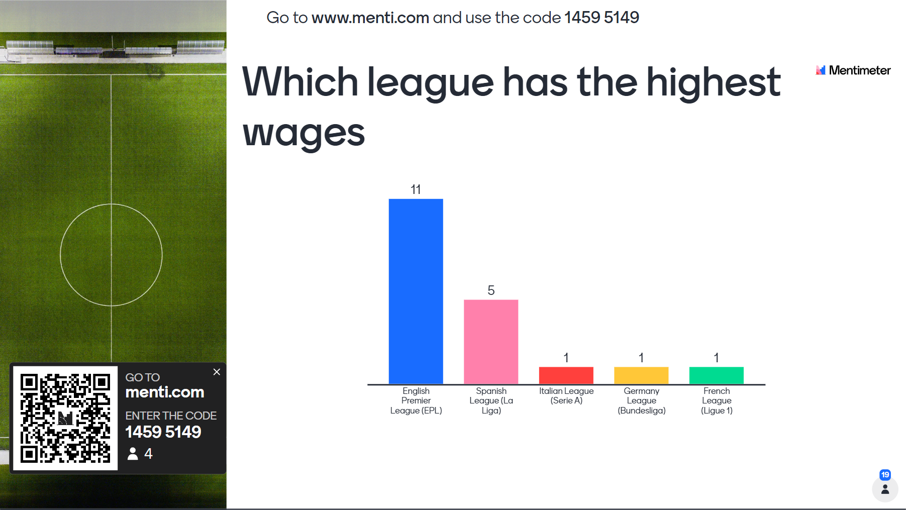

Class Polls

Slide 9
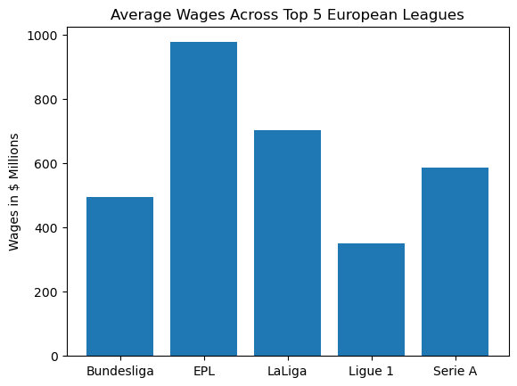
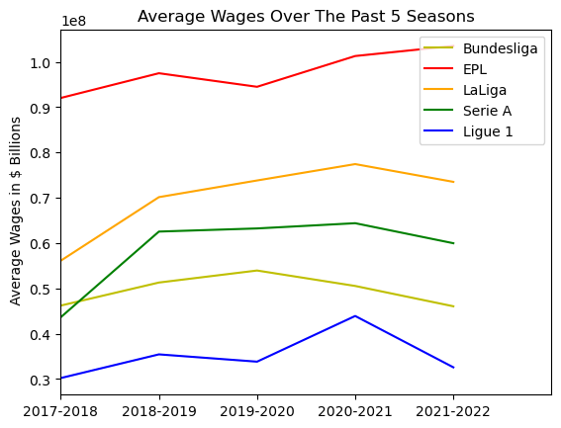
Conclusions and Summary – Team Stats Wages
Notes:
The English Premier league has the height wages of the 5 leagues while the French league has the lower salary

Slide 10

Class Polls

Slide 11
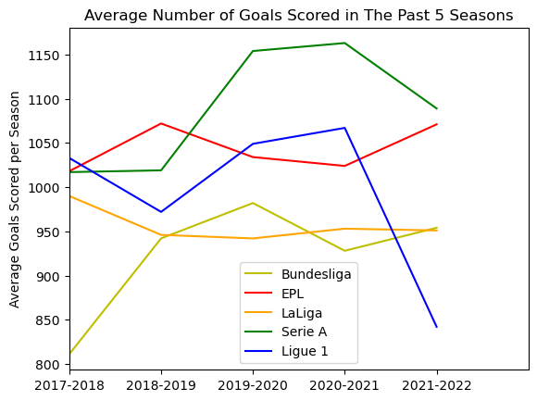
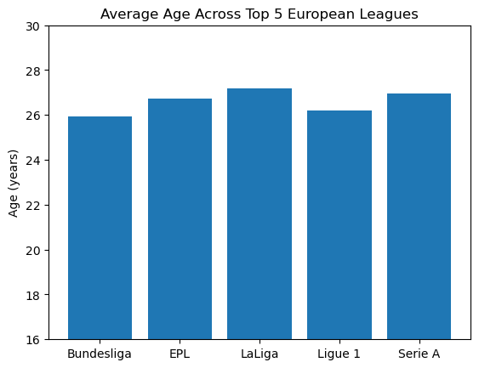
Conclusions and Summary – Team Stats Goals Scored and Average Age
Notes:
Serie A had the high average wages of 5 seasons with the teams average age fairly similar.

Slide 12
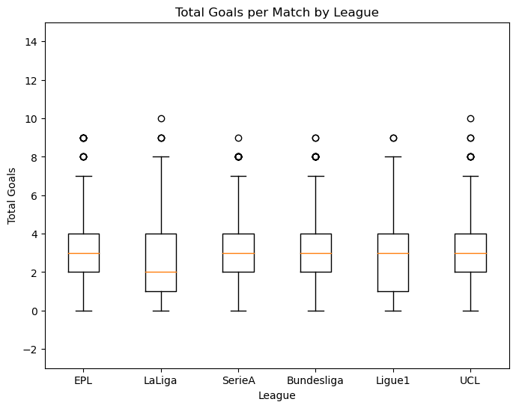
Conclusions and Summary – Team Stats Total Goals Scored per Match
Notes:
Total goals are most variable in France. The median goals in the Spanish league is lower than the other 5 leagues.

Slide 13
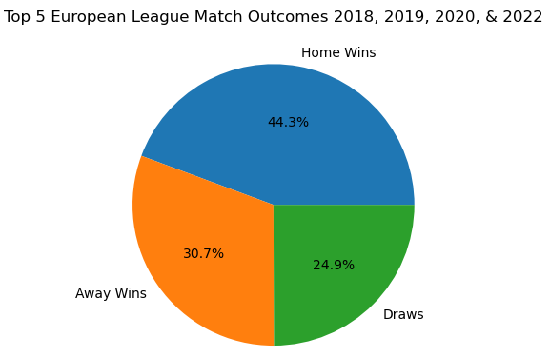
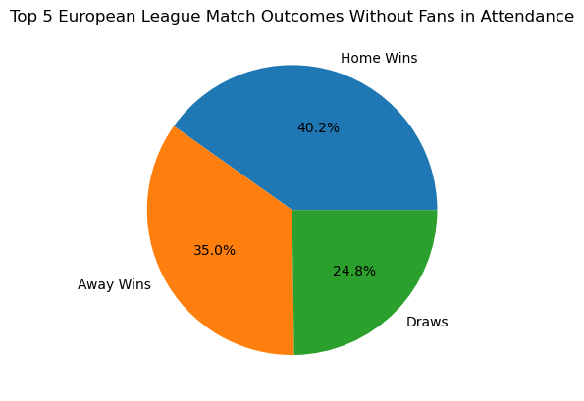
Conclusions and Summary - Attendance
With the COVID Season and no fans allowed in the stadium we investigated if fans helped the home team win
Notes:
Home teams won 4.1% fewer games during the period where fans were not allowed to attend games.

Slide 14
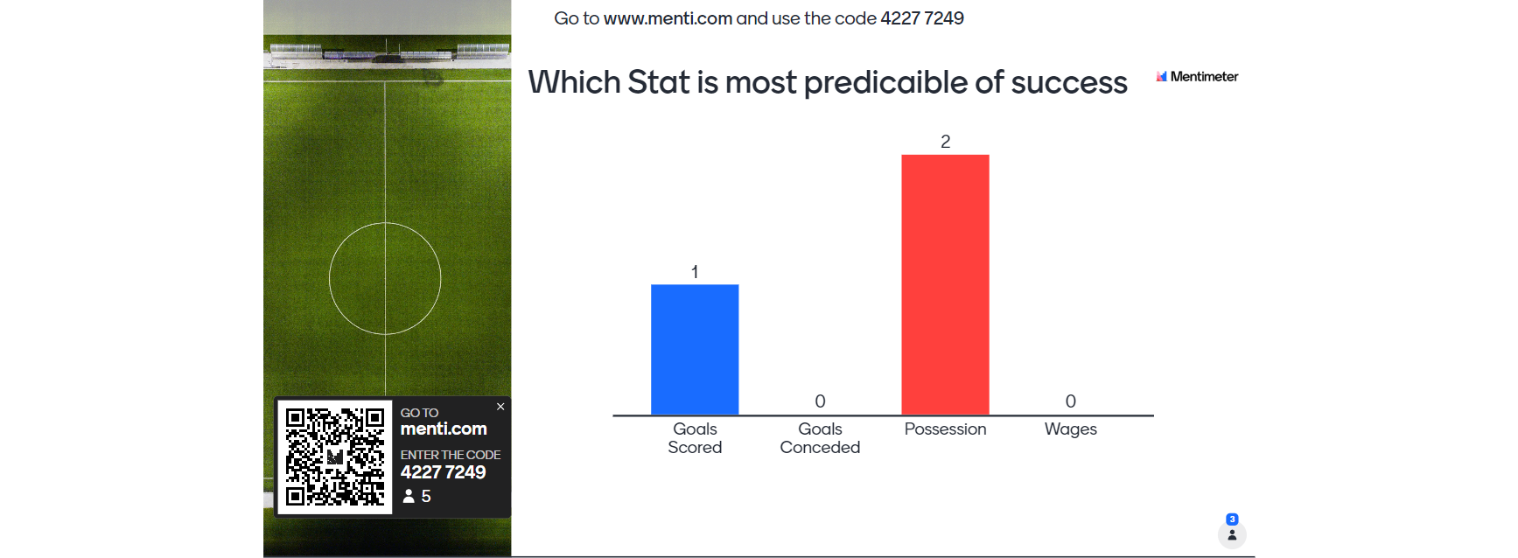
Class Polls

Slide 15
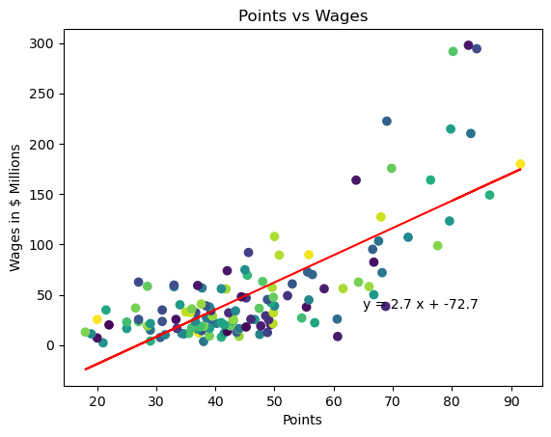
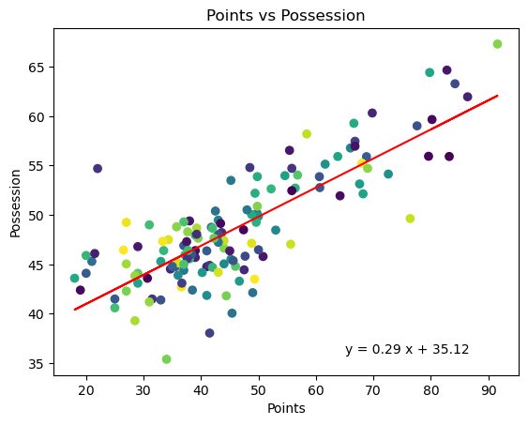
Conclusions and Summary – Match Results
Annual Wage: r-squared is 0.56
Possession: r-squared is 0.65
Notes:
Average squad wages shows the weakest correlation with team success (r^2 =0.5). It turns out money doesn't necessarily buy wins!
Ball possession percentage shows a moderate correlation with team success (r^2 = 0.62)

Slide 16
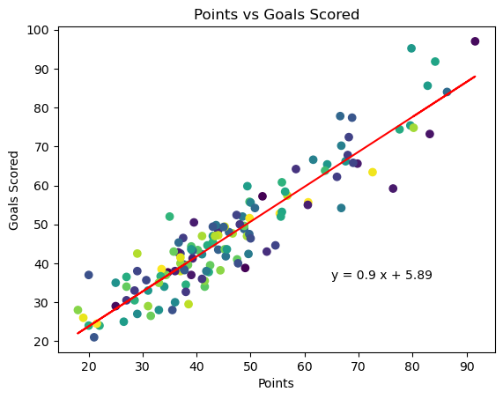
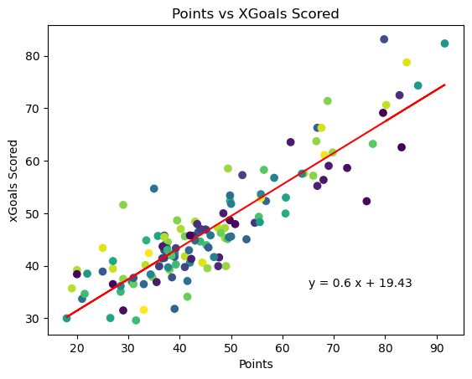
Conclusions and Summary – Match Results
Actual Goals Scored: r-squared is 0.86
Expected Goals Scored: r-squared is 0.79
Notes:
Goals scored show the strongest correlation to team success (r^=0.85), more so than goals conceded (r^=0.7). Based on this analysis we can say that teams who implement an offensive style of play are more likely to succeed relative to expectations compared to teams who play a defensive style. This makes sense when you consider that a team's margin of error becomes extremely small when fewer goals are scored in their games on average.
The expected metrics themselves are moderately correlated with team success (r^=0.78 and (r^=0.64) respectively. However, there is still a sizeable gap in the r^2 values of expected goals versus actual goals which signifies that these metrics are still far from perfect when it comes to predicting future performance.

Slide 17
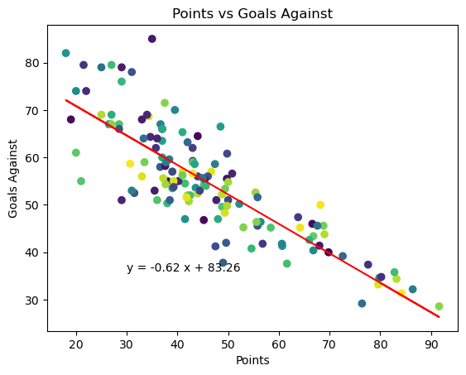
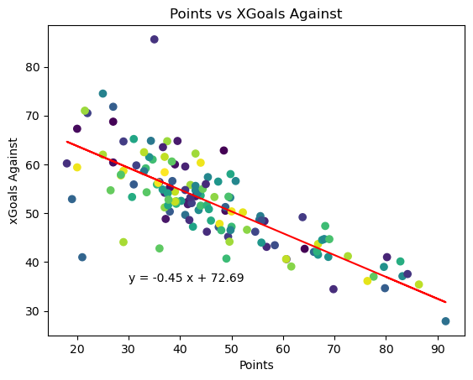
Conclusions and Summary – Match Results
Goals conceded Actual: r-squared is 0.70
Goals conceded Expected: r-squared is 0.60

Slide 18
Implications
We originally had a false assumption that average age and wages played a part in team success
One area not considered in our analysis was weather conditions and elevation. Typically, across the European Leagues elevation will not be a factor but in other countries it may contribute to team results.

